Slide 1
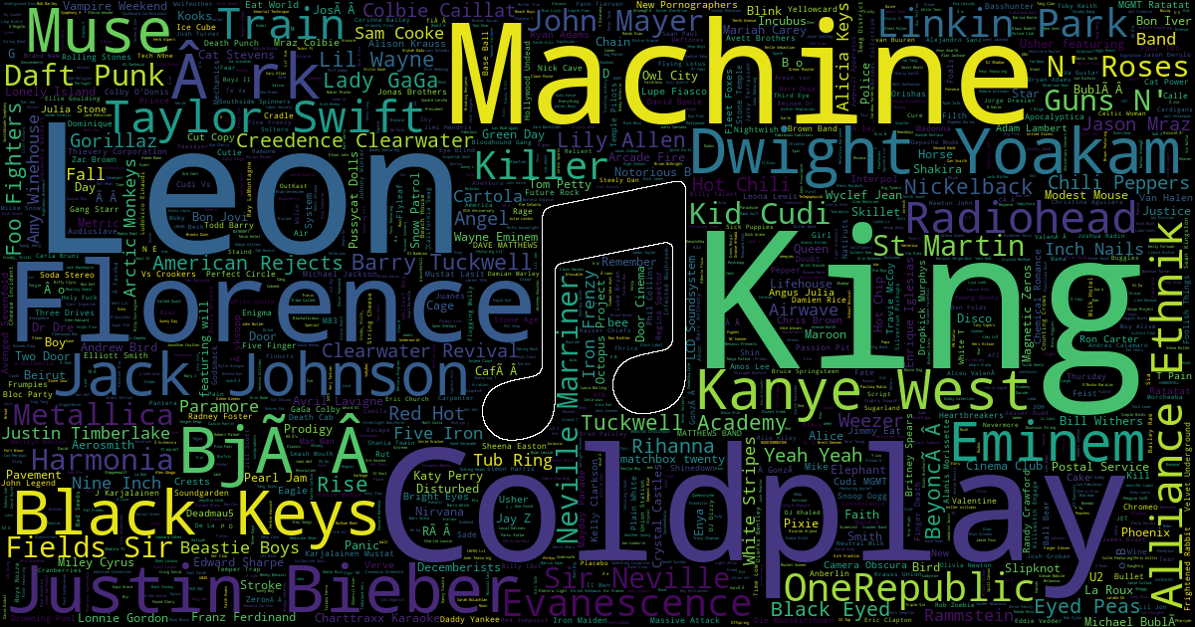
Spotify Users Churn Prediction
WEB AND SOCIAL ANALYTICS
INSY 5377-001
Summer 2022
By:
Mantena, Surendra Varma (1001956606)
Instructor:
Dr. Riyaz Sikora

Slide 2
Contents:
Introduction
Overview
Problem Statement
Goal
Challenges
Data Description and Source
About Dataset
Data Exploration and Analysis
Research Questions
Methodology
Data Preprocessing
Feature Extraction
Results and Discussion
Data Modeling results
Conclusion

Slide 3
Introduction:
Overview:
Spotify is a music service application for cell phones and computers
Millions of users listen to their favorite songs every day, either through a free tier plan (plays adds) or through a premium subscription model ( add - free)
Users can upgrade or downgrade their subscription plan at any time, as well as cancel it entirely.
Problem Statement:
Businesses must keep their customers in order to thrive. Churn (the process of losing customers) is thus a significant business problem.
Goal:
Using the data logs, The goal is to identify customers who are likely to leave the service, or who would downgrade from a premium or free subscription to a cancellation.

Slide 4
Introduction …..
Challenges:
Imbalanced dataset
Identify Target variable. The dataset we have is a multi- class classification dataset with multiple target variables. We are aimed to convert multi-class classification to binary classification and predict if a user is Churned or Not.
X | Y
X1 | t1
X2 | t2
X3 | t3
X4 | t2
X5 | t4
X6 | t1
X | Y
X1 | t1
X2 | t2
X3 | t1
X4 | t2
X5 | t2
X6 | t1
X | Input Variables
y | Target Variables
Multi- class Classification
Binary Classification

Slide 5
Data Description and Source:
About Dataset:
We have taken the dataset from Kaggle.com
Data logs are generated whenever a user interacts with a music streaming app, whether it is playing songs, adding them to playlists, rating them with a thumbs up or down, adding a friend, logging in or out, changing settings, etc.
The original dataset is 12GB, but for this project, we used a subset dataset with 18 columns and 286500 rows
The full data set contains logs from 22277 different users, whereas the subset only includes 225 user’s activities.
12 of the 18 columns are strings, and it appears that we are mostly dealing with categorical variables.
We note that there are three types of columns describing the dataset.
User identifying information:
userId (string)
firstName (string)
lastName (string)
Location (string)
Gender (string)
userAgent (string)
Session/Account information
sessionId (int)
level (string)
auth (string)
itemInSession (int)
length (double)
Activity information
song (string)
artist (string)
page (string)
activity timestamp (int)
registration timestamp (int)

Slide 6
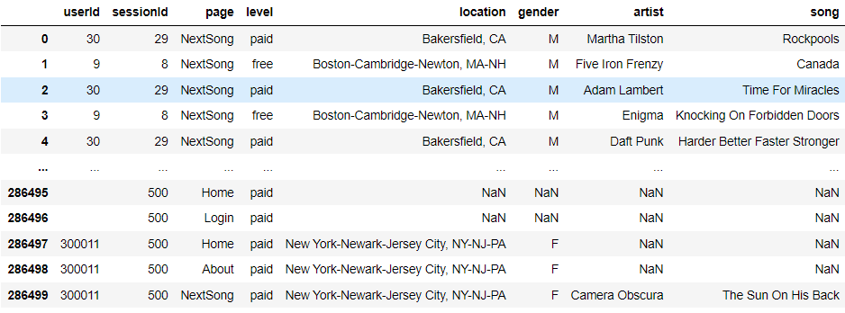
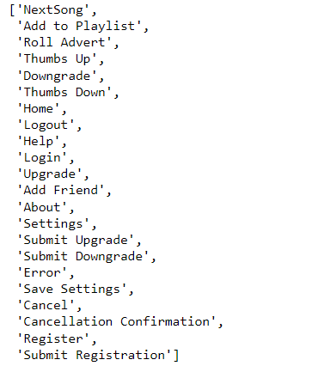
Data Exploration and Analysis…..
Column: Page
The Page column holds the important information of user interactions with a music streaming app.
Overall, the page column in our dataset has 22 different variables.

Slide 7
Research Questions
Find out if the usage activity of paid and free users has changed over time?
Find out the activity of subscription downgraded users before clicking the downgrade submit button and What could be the cause of their downgrade?
Find out the activity of subscription upgraded users before clicking the upgrade submit button and What could be the cause of their upgrade?
Top ten songs played by the most unique users?
Top 15 Artists whose songs were trending over the period of time?
Which region has the most users of the application?
What is the average app usage by cancelled (no longer using app) and not cancelled (still using app) users, as well as possible app cancellation reasons.

Slide 8
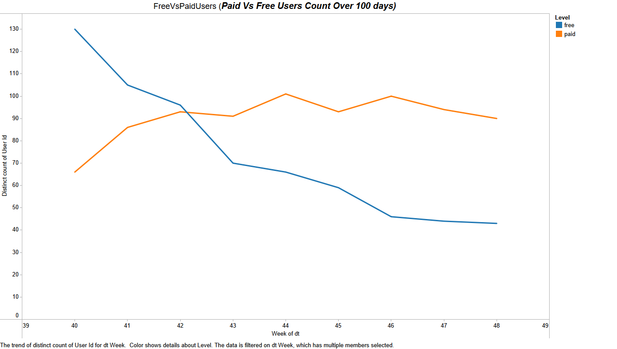

Slide 9
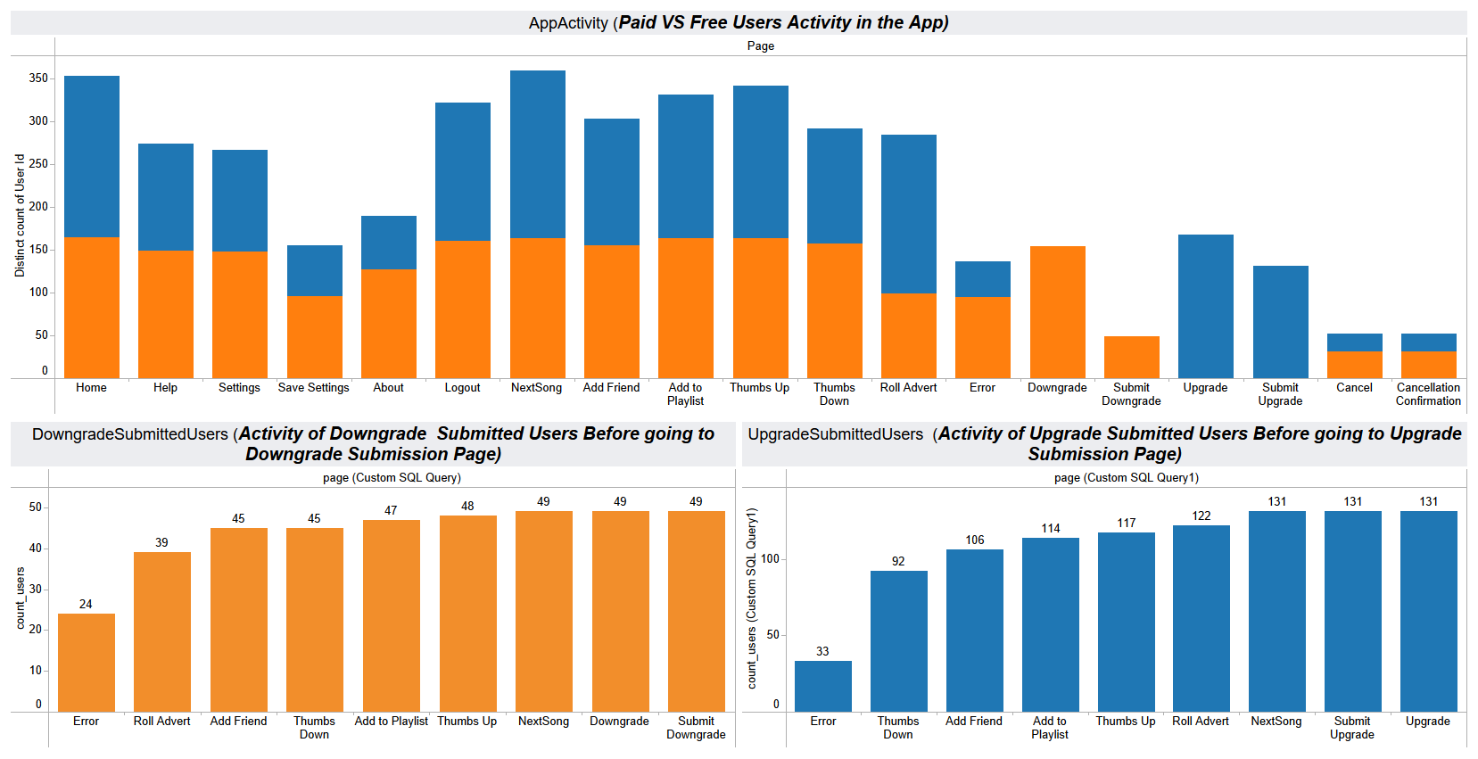


Slide 10
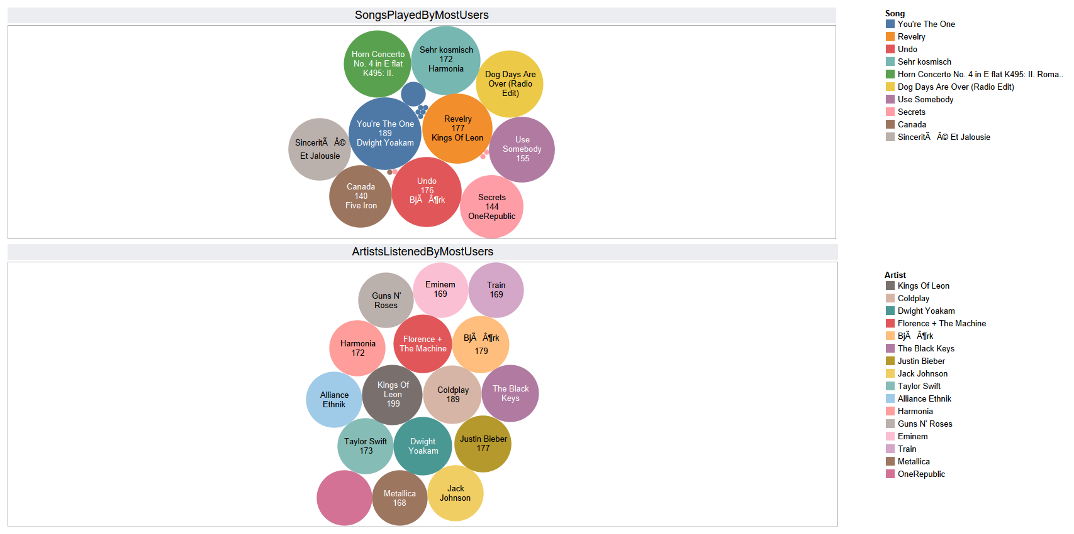
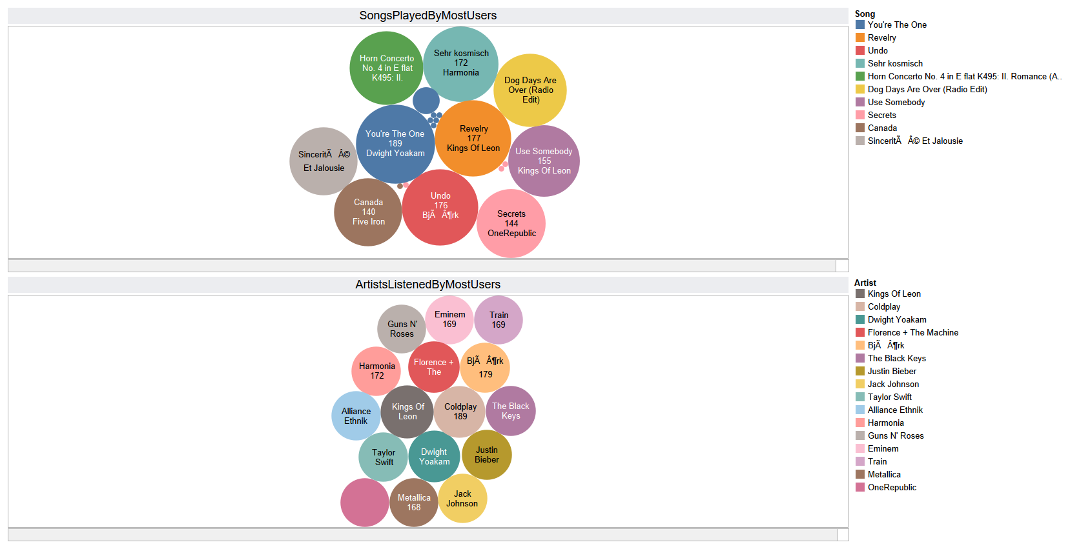

Slide 11
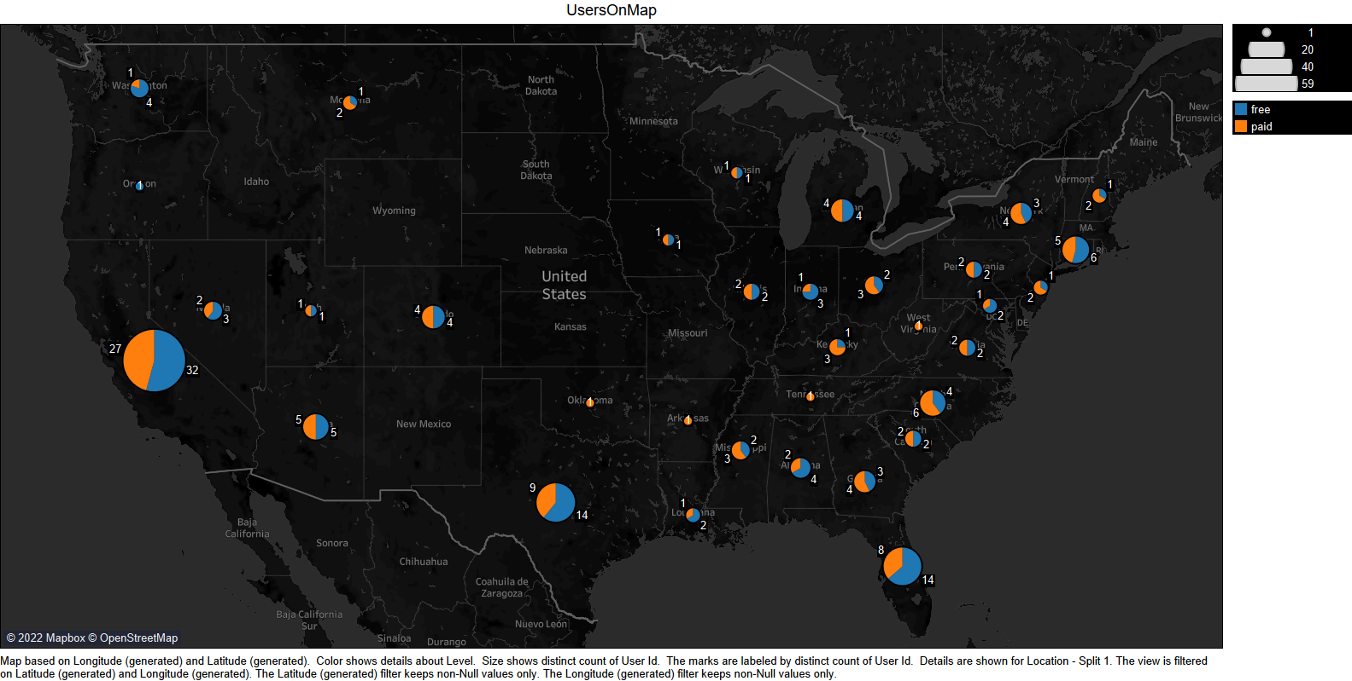

Slide 12
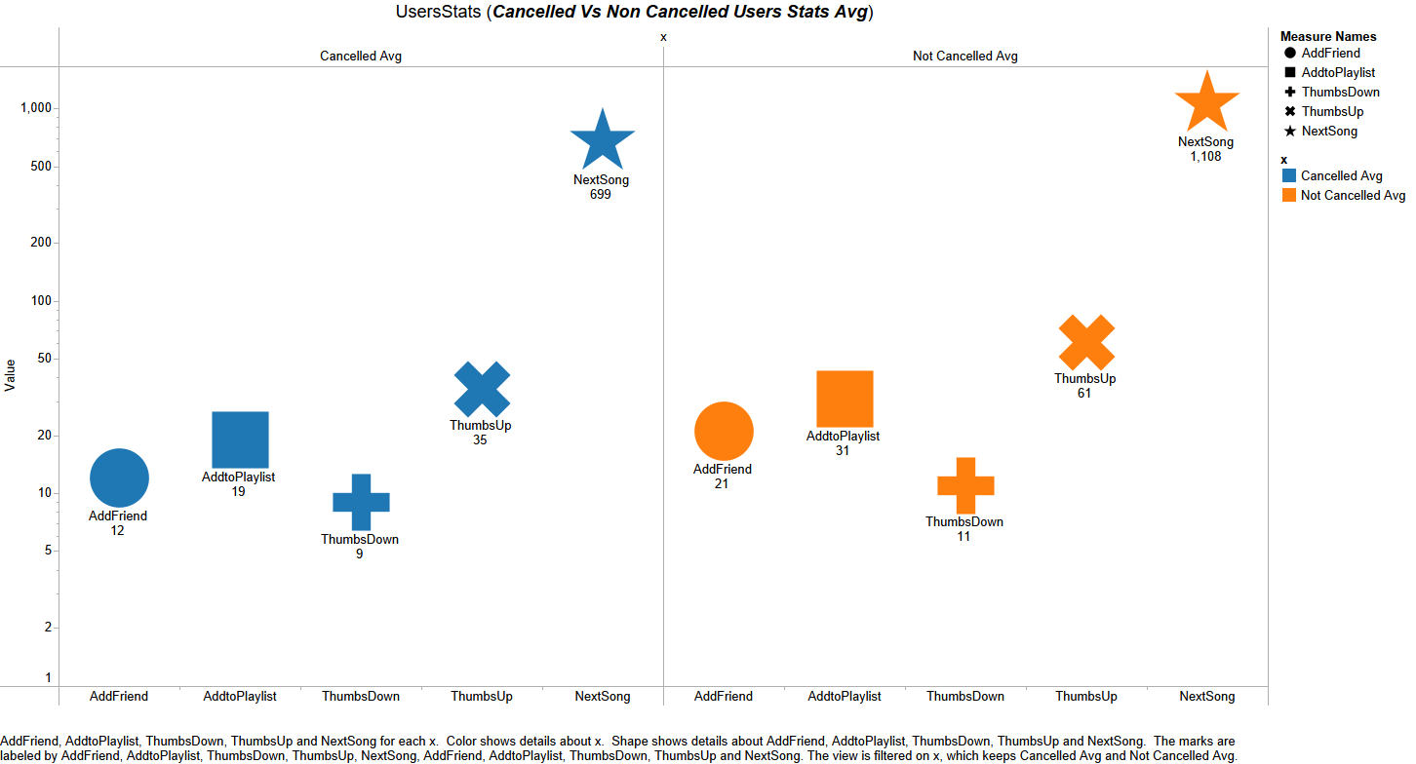

Slide 13
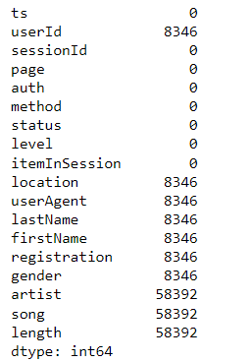
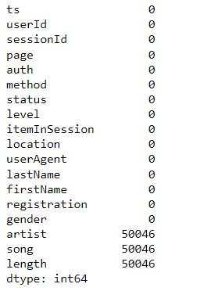
Methodology: 1.Data Preprocessing
Missing/Null Values:
UserId, location, useragent, lastname, firstname, registration, and gender all have 2% Null values.
Artist, song, and length all contain 20% Null values.
Observations:
userId with Null values most likely represents a user(s) who are currently signing in or prior to registration. Also the same users are having Null values for Location, Name, gender, etc. columns. As a result, rows with null userId are dropped.
The artist, song length, and song information are only available for the page event "NextSong.“ and values for all other events in the Page column are null. we can't remove rows or columns of these null values as they will explain the churn prediction.
These Null values are handled by finding out the last user action before that Null observation is generated and filling the null observation with those values.
Dropping Null userId values

Slide 14
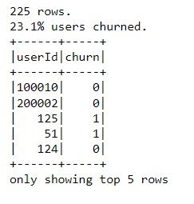
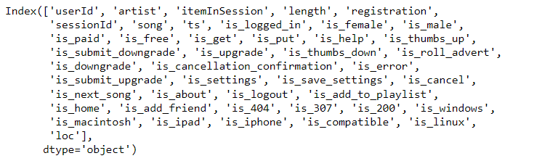
Methodology: 2.Feature Extraction:
Defining Churn feature:
In our project, churn is defined as users who have the 'Cancellation Confirmation' page.
We find that 23.1% of users have churned.
The new features (35) that were extracted from the original dataset are shown below.
For improved prediction, all new features have been transformed to binary classification.

Slide 15
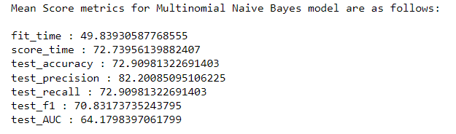
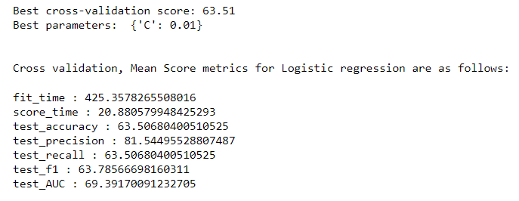
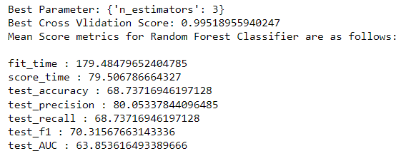
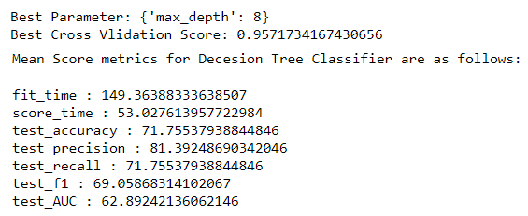
Methodology: 3.Data Modelling
Multinomial Naïve Bayes Results:
Baseline Model: Logistic Regression Results:
Random Forest Classifier Results:
Evaluation metrics:
On imbalance datasets, accuracy would be an inappropriate metric to evaluate.
The F1 score is a balance of precision and recall. When predicting churn, precision aims to ensure that it is really a churn, whereas recall aims to avoid missing any true churns, which is why F1 score is used to evaluate model performance.
Decision Tree Classifier Results:

Slide 16
Conclusions:
Our machine learning model can reasonably predict churn (with f1 score of 70.83). Model performance can be improved further by tweaking the hyperparameters or incorporating new features.
Naïve Bayes Stand out to be the best model. Also, Random Forest have almost same f1 score as Naïve Bayes.
Most of the Users are downgrading the subscription from paid to free. One of the reason could be because of ‘Errors’ and ‘Roll Adverts’ that should be taken care of.
Overall, Cancelled users use the application far less than all other users. Businesses must attract users in order to increase user usage.
Further Improvements:
Use Scaling and Normalization
Use PCA to use the dimensionality of features.

Slide 17
Thank You!

